Slide 1
Software Development
Localization, Translation, Globalization.

Slide 2










What is a Locale?
In computing, a locale is a set of parameters that defines the user's language, region and any special variant preferences that the user wants to see in their user interface.
Usually a locale identifier consists of at least a language identifier and a region identifier.

Slide 3
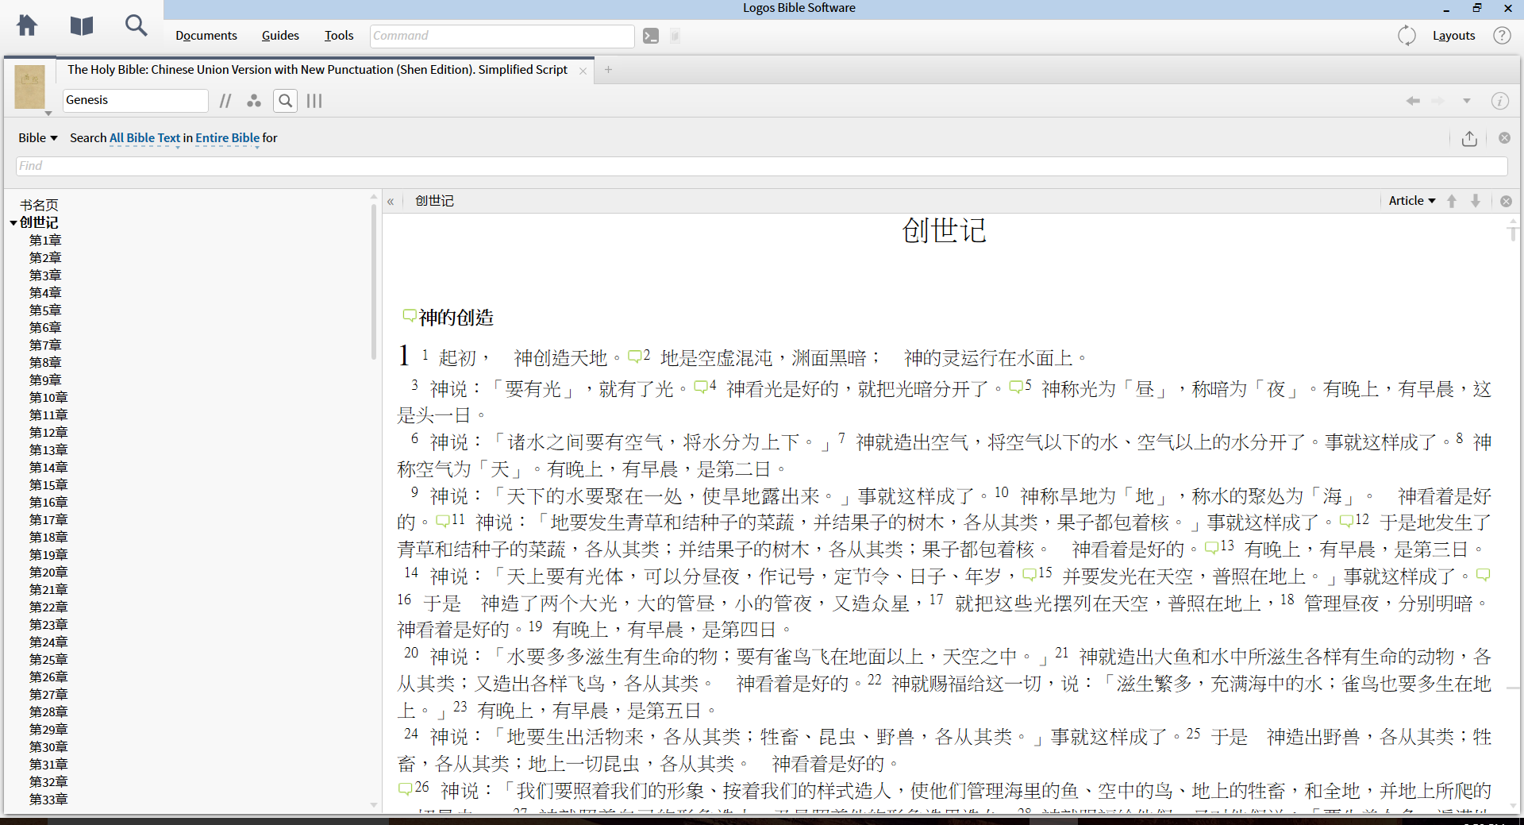
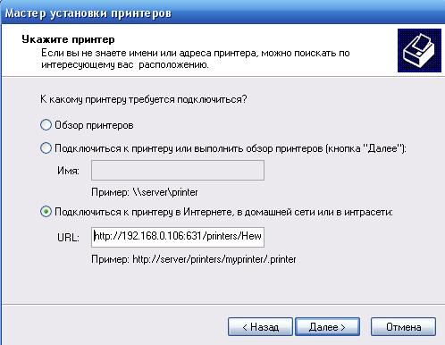
Language
It is important to ensure that the user is able to understand the software they are using.

Slide 4

Units
While many users have a rough idea of the conversions between Metric and Imperial measurements, it is much easier for them to relate to the information if it is in the system they are accustomed to.

Slide 5
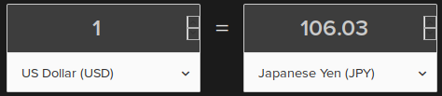
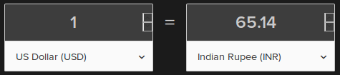
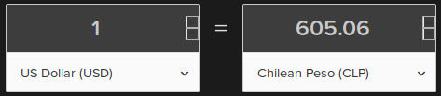
Currency
Currency conversion values vary wildly not only depending on the currency, but even on the day or time of year.
Properly configuring currency values is critial for any software that hopes to be international.

Slide 6
Formatting
Formatting large numbers and numbers with decimal places is another aspect of locale that is quite unique in different countries.
Notice how some even differ by default number of decimal places.
Canadian - 4 294 967 295,000
German - 4 294 967.295,000
Norwegian - 4.294.967.295,000
Spanish - 4.294.967.295,000
Swedish - 4 294 967 295,000
GB-English - 4,294,967,295.00
US-English - 4,294,967,295.00

Slide 7
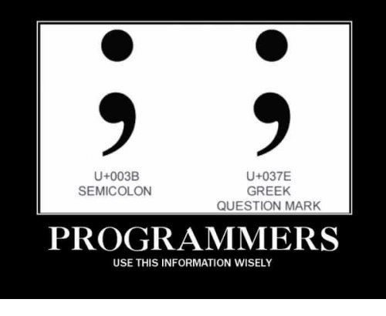
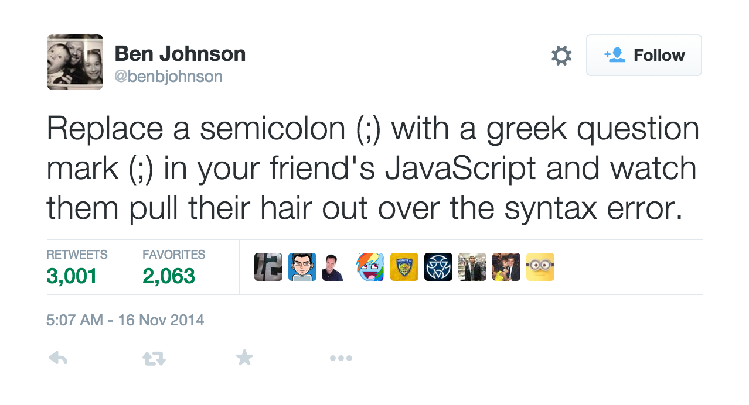
Characters
In some cases it is even important to ensure the correct unicode characters are being used.

Slide 8
Translation vs. Localization vs. Globalization

Slide 9
Translation
“The rendering of something into another language or into one's own from another language.”
Translation is typically not the responsibility of the Software authors.
Most programmers will depend on the efforts of dedicated translators.

Slide 10
Translation (cont.)
The actual effort of translating the text in software to another language will often not be your responsibility.
However, you will be responsible to write software in a way that allows other languages to be easily used.

Slide 11
Localization
Localization is the term generally used to describe the implementation of the different Units, Currencies, Formats, and Abbreviations.

Slide 12
Localization (cont.)
It is generally not necessary to translate software written in the United States for use in Great Britan.
But while a common language is shared between the two locales there are many differences.

Slide 13
Localization (cont.)
Users respond best to software they feel has been written with their demographic in mind.
Differences in spelling (Gray/Grey or Color/Colour) and units can lead users to feel the owners of the software they are using do not care about them.

Slide 14
Globalization
Globalization can be thought of as a combination of both translation and localization.
By translating software to a user’s native language, and using formatting/units they are familiar with, you enable them to use your software to its fullest potential.

Slide 15
Globalization (cont.)
Globalization, however, also includes another challenge: input.
Usually the OS is responsible for handling different keyboard layouts. As such you will not typically be responsible for writing an individual device driver per implementation.

Slide 16
Globalization (cont.)
Correctly displaying the right string of text on a button becomes more and more challenging as you increase the number of target locales.
While this can be challenging, properly handling user input is even more difficult. You will be responsible for parsing and sanitizing their input.

Slide 17
Localization & Globalization Techniques

Slide 18
Implementing Functionality
No matter the Locale, a “GO” button should always work as the go button.
This will often incentivise software developers to create a button, title it something like button_Go, and to put GO in its text value property.

Slide 19
Implementing Functionality
In a development community so heavily dominated by the Agile Development Process, the drive to implement functionality can trump all desire to spend time on things like Localization etc.
However, a small amount of time spent from the beginning will save large amounts of time later on.

Slide 20
Key-Value Pairs
Key-Value pairs can be used as an efficient way to handle multiple translations of a single object.

Slide 21
Key-Value Pairs (cont.)
Using the same “GO” button example:
The button can still be named button_Go, but fetching the text value from a key-value pair instead of hard coding the text allows that button to dynamically adapt to the set locale.

Slide 22
Binary Localization
The world is full of multi-lingual people who are fully capable of translating aspects of your program.
Often the difficult part is not finding someone who can translate. But someone you can trust with the source code to your project.

Slide 23
Binary Localization (cont.)
Binary Localization is the practice of sharing an already compiled version of your software with the person/people responsible for a translation.
The use of configuration files allows a translator to test the accuracy of translations without the need to modify or view source code.

Slide 24
Resource Files
After the work of translation has been completed the configuration files can be used to create resource files.
The difference between a configuration file and a resource file is that a configuration file is stored in plain text, and is user customisable.

Slide 25
Resource Files (cont.)
Resource files are less resource intensive and are more secure.
Multiple resource files can be bundled with the software, allowing on the fly changes between different globalization settings.

Slide 26
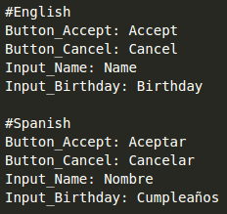
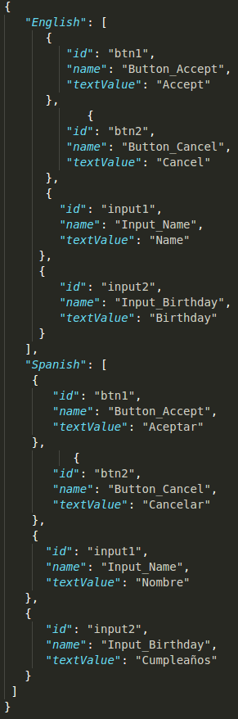
Configuration/Resource Files

Slide 27
Configuration/Resource Files
The configuration file takes up less lines in a document, but it is more difficult to parse and contains less information.
The JSON resource file contains very useful and easy to parse information that can be quickly loaded into any data structure you see fit.

Slide 28
Helpful Localization Tips

Slide 29
1: Plan ahead
For many companies, software localization turns out to be a last-minute rush before a product release.
All localization scheduling and scoping efforts should take into account the translation, testing, and regression that must occur to produce a quality product.

Slide 30
2: Test your software
In most cases, localized software should be tested as rigorously as the original English software.
There's no replacement for the awareness that comes with seeing a foreign language "in context" within your software.

Slide 31
3: Develop a detailed English test plan
Use this same test plan in your localized testing. The same crucial UI dialogs and functionality will be put to the test.
Reusing the English test plan for localization testing is common in the industry and will avoid delays in localization testing.

Slide 32
4: Leave lots of space for other languages
Many languages take up to 30 percent more space than English!
If you design the software in a way that English barely fits, you'll have a problem down the road.
Leave ample space or program dynamic UI expansion into your software.

Slide 33
5: Minimize “Freestyle” user input
Properly parsing, filtering, and cleansing user input in one language can already be challenging.
Introducing different input formats only compounds this issue.
Applying the same principles from the user interface to available user input helps mitigate this issue.

Slide 34
6: Use localization-friendly encoding of strings
When possible, source your string tables or software resources in Unicode/UTF-8 encoding. This will avoid extra conversion steps, time-consuming debug work, and garbled text.
Some languages like C# have built in string formatters that accept localizations as parameters.

Slide 35
7: Perform "pseudo localization" to root out hard-coded strings
Use a regular expression to replace all letters in the string text with a single repeating character, such as "XXXXX."
Build the software, and any hard-coded text will really jump out at you, showing strings that are not defined in string tables.

Slide 36
8: Avoid concatenation and overuse of single strings
A combination of words in English will most likely not follow the same order in most other languages.
Concatenated strings and strings that are used in multiple contexts will have grammar and gender agreement issues.
Many modern systems have plenty of resources to allow for a larger collections of objects, so be generous when localizing your product.

Slide 37
9: Provide internationalization support in your software
This will enable dates, numbers, and other region-specific data such as currency to show up in a familiar and comfortable way to all users around the world.

Slide 38
10: Provide numerous comments in software resources that define context
Knowing the context and use of certain strings will help translators choose the right translation from the beginning.
Most translation tools will allow translators to see these comments as they translate the strings.

Slide 39
11: Perform localization of Help and software (GUI) at the same time
Users around the world will notice when context-sensitive help tells them to click on a button that is worded differently in the software itself.
Handle both your software and Help/User's Guide at the same time to ensure consistency between your software and help documentation.

Slide 40
Implementing the Agile Process

Slide 41
As was previously mentioned, implementing globalization from the beginning will often not be a top priority of a developer who is following the Agile Development Process.
Following are the steps to implement globalization using Agile.

Slide 42
1: Prep for Translation / Locale File Creation
The first step is to ensure that the software is ready for translation.
This entails verifying that all elements of the Help/UI are dynamically pulling from a resource file and not hard coded.

Slide 43
2: Extracting a Copy for Translation / Locale File Creation
Next a version of the software must be created that is based off of a configuration file instead of the resource files.
This allows the translator to make changes and ensure they are properly reflected.

Slide 44
3: Briefing Of Translators / Styleguide
The selected translators should be taught how to properly use the configuration files.
This will allow them to make changes without your help.
A style guide is tremendously helpful in situations with more than one translator. It will allow for continuity and uniformity across the UI.

Slide 45
4: Review
It can sometimes be difficult to evaluate the exact accuracy of a translation (Conveying correct meaning/feeling and not just correct words).
It is still critical that the translations be verified and proofread by the original translator, as well as a different person.

Slide 46
5: Integration Of Translation Files
After a configuration file has been successfully created it must be converted into a resource file that can be used with the original version of the software.

Slide 47
6: Testing
Apart from testing functionality has been preserved, it is important to verify that the new translation has been correctly applied.
It is important the software be tested by someone who uses the target locale to ensure ease and accuracy.
It can be helpful to have someone who does not speak the language test the software in the given locale to ensure that functionality is identical.

Slide 48
6: Testing (cont.)
Another key aspect of testing is ensuring it is easy for users not of the default locale to switch to their desired local.
Apart from finding the setting and correctly identifying the one they wish to switch to, it should also be a smoothe transition between them.

Slide 49
7: Delivery
Make the software available to people from all locales you care to receive feedback from.
It can be tempting to to a minimal release only to an english demographic. This will however prevent other user’s input being taken into account if any changes must be made.
This can lead to further issues down the line if their concerns are not dealt with promptly, as updates may need to be rolled back for everyone.

Slide 50
Conclusion and Questions

